Slide 1
Analog VLSI Circuit Final Project
Presented By-
Group-4
Akash Ganguly – SC18B072
Kothadiya Prince - SC18B078
Kshitij Singh – SC18B079
Aditya Amrit – SC18B087
Vivek Garg – SC18B093
Notes:
Good Morning Sir, Sir, we Group – 4 will be presenting on fully differential Opamp with rail-to-rail input with CMFB. The members of our group are Akash, Prince, Aditya, Vivek and myself Kshitij
Moving on to Contents or overview what we will be discussing is:

Slide 2
Contents
CMFB
Design
Buffer Design
Results & Analysis
2nd Stage Design
Design Calculation
Results
Final Results & Conclusion
References
Objective
Design Requirement
Current Mirror Network
Cascode pair biasing
Folded Cascode Design
Design Calculation
NMOS-PMOS-Overall Design
Results
Notes:
Here, We have

Slide 3
Objective

Slide 4

Design Requirements
$A_{v}≥70 dB$
$UGF≥100MHz$
Fully Differential OpAmp
Rail-to-Rail input capability
CMFB
$C_{L}=500fF$
Notes:
Gaim more than 70dB

Slide 5
Current Mirror

Slide 6
Current Mirror
Notes:
Using 10 micro amplere current source
4 Legs –M1, M11M2, M12,13,14 , M20,15,19
Source se transistor ko bias kr rhe hai...
NMOS The tail current sourcess... ye bias kr rhe hai
M1 and current se koi bhi bias kr skte
M11 se Vtp Bias kr rhe
M13,14 se koi bhi cascode ko bias kr skte Vb2 ko bias kiya Vb1
M15,20 cascode ke upar wale pmos ko bias kr rhe Vb3,4
Vtp – pmos ka tail current course.. M11 (size-2) ka replicate krega.. At M0p (size-27)..so 13.5 times zada current..
Vtn – nmos ka tail current – M1 ka current replicate krega.. At M0n (size-32) so 16 times zada and also bias nmos tail current 2nd stage, CMFB and buffer
Vb1 - replicate current from M14, at M3 M4 (size-27) so 13.5 times zada current..
Vb2 - replicate current from M13, at M5 M6 (size-15) so 7.5 times zada current..
Vb3 - replicate current from M15(size-4), at M7 M8 (size-31) so 7.75 times zada current..
Vb4 - replicate current from M20(size-4), at M9 M10 (size-62) so 15.5 times zada current..

Slide 7
Current Mirror
V_{tp} – biases PMOS Tail Current for M0p Transistor
V_{tn} – biases NMOS Tail Current for M0n Transistor and others
V_{b1} – biases M3 and M4 Transistor( Lower NMOS Stack)
V_{b2} – biases M5 and M6 Transistor(Upper NMOS Stack)
V_{b3} – biases M7 and M8 Transistor(Lower PMOS Stack)
V_{b4} – biases M9 and M10 Transistor(Upper PMOS Stack)
Notes:
Vtp – pmos ka tail current course.. M11 (size-2) ka replicate krega.. At M0p (size-27)..so 13.5 times zada current..
Vtn – nmos ka tail current – M1 ka current replicate krega.. At M0n (size-32) so 16 times zada and also bias nmos tail current 2nd stage, CMFB and buffer
Vb1 - replicate current from M14, at M3 M4 (size-27) so 13.5 times zada current..
Vb2 - replicate current from M13, at M5 M6 (size-15) so 7.5 times zada current..
Vb3 - replicate current from M15(size-4), at M7 M8 (size-31) so 7.75 times zada current..
Vb4 - replicate current from M20(size-4), at M9 M10 (size-62) so 15.5 times zada current..

Slide 8
Current Mirror
Notes:
4 Legs –M1, M11M2, M12,13,14 , M20,15,19
Source se transistor ko bias kr rhe hai...
NMOS The tail current sourcess... ye bias kr rhe hai
M1 and current se koi bhi bias kr skte
M11 se Vtp Bias kr rhe
M13,14 se koi bhi cascode ko bias kr skte Vb2 ko bias kiya Vb1
M15,20 cascode ke upar wale pmos ko bias kr rhe Vb3,4
Vtp – pmos ka tail current course.. M11 (size-2) ka replicate krega.. At M0p (size-27)..so 13.5 times zada current..
Vtn – nmos ka tail current – M1 ka current replicate krega.. At M0n (size-32) so 16 times zada and also bias nmos tail current 2nd stage, CMFB and buffer
Vb1 - replicate current from M14, at M3 M4 (size-27) so 13.5 times zada current..
Vb2 - replicate current from M13, at M5 M6 (size-15) so 7.5 times zada current..
Vb3 - replicate current from M15(size-4), at M7 M8 (size-31) so 7.75 times zada current..
Vb4 - replicate current from M20(size-4), at M9 M10 (size-62) so 15.5 times zada current..
R -> 200 to 300 mv drop approx. to Vth drop because we are using a low voltage cascode bias circuit

Slide 9
Folded Cascode Rail-to-Rail Design

Slide 10
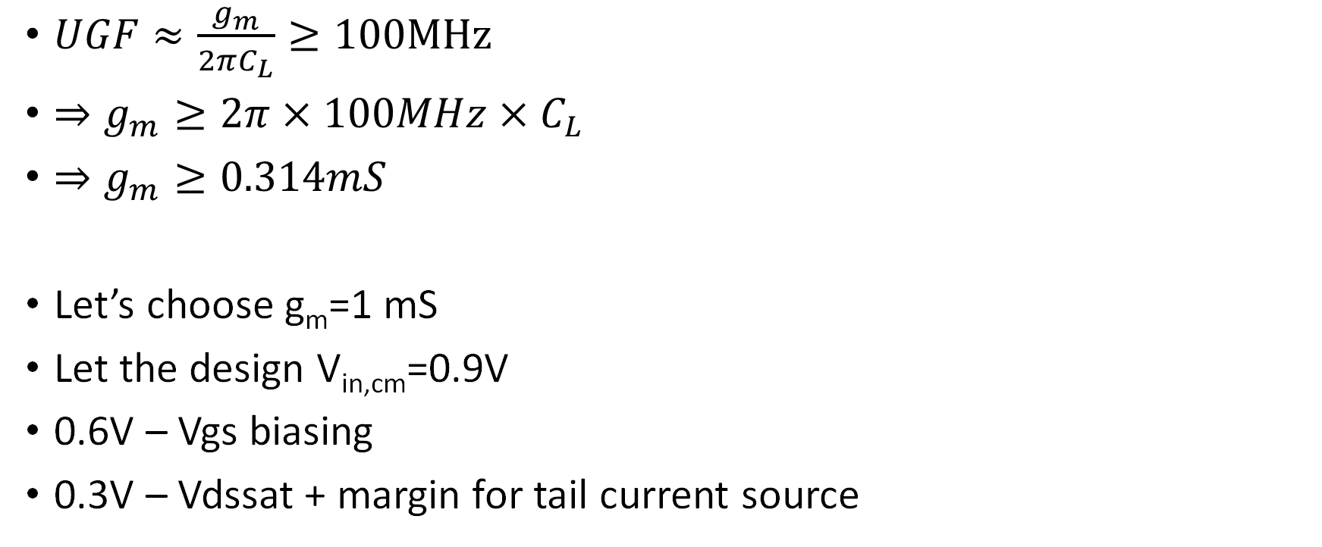
Design Budgeting
$UGF≈\frac{g_{m}}{2πC_{L}}≥100MHz$
$⇒g_{m}≥2π×100MHz×C_{L}$
$⇒g_{m}≥0.314mS$
Let’s choose g_{m}=1 mS
Let the design V_{in,cm}=0.9V
0.6V – Vgs biasing
0.3V – Vdssat + margin for tail current source

Slide 11
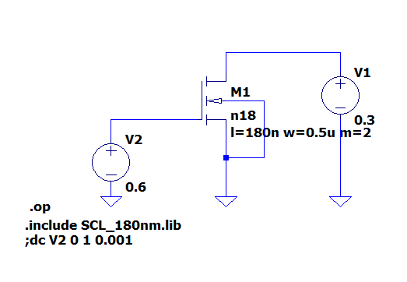
NMOS Characterization
Id: 1.13e-05
Vgs: 6.00e-01
Vds: 3.00e-01
Vbs: 0.00e+00
Vth: 4.82e-01
Vdsat: 1.30e-01
Gm: 1.34e-04
We must scale NMOS such that g_{m}=1mS
W_{req.d}=7.4*W₁

Slide 12
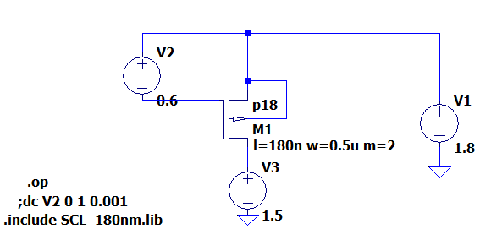
PMOS Characterization
Id: 1.62e-06
Vgs: 6.00e-01
Vds: 3.00e-01
Vbs: 0.00e+00
Vth: 5.16e-01
Vdsat: 9.91e-02
Gm: 2.35e-05
We must scale PMOS such that g_{m}=1mS
W_{reqd}=42.5*W₁

Slide 13
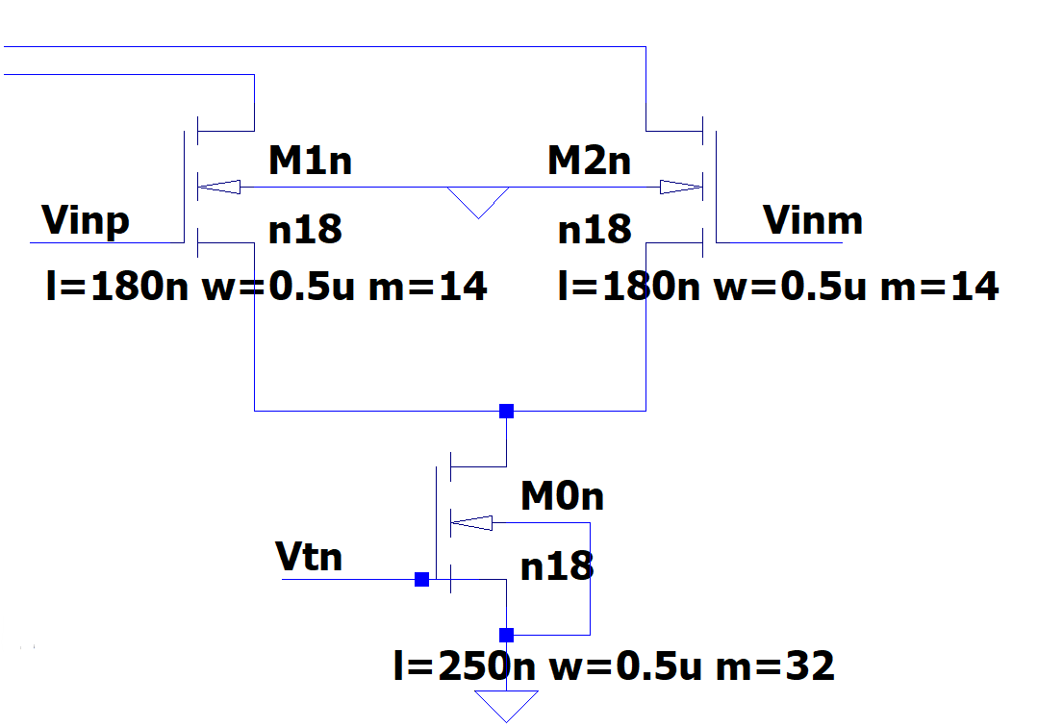
NMOS Input Pair
Name: m1n m2n
Model: n18 n18
Id: 7.39e-05 7.39e-05
Vgs: 6.17e-01 6.17e-01
Vds: 1.27e+00 1.27e+00
Vbs: -2.83e-01 -2.83e-01
Vth: 5.30e-01 5.30e-01
Vdsat: 1.12e-01 1.12e-01
Gm: 9.75e-04 9.75e-04
Gds: 1.99e-05 1.99e-05
m0n
n18
1.48e-04
5.93e-01
2.83e-01
0.00e+00
4.63e-01
1.42e-01
1.69e-03
5.83e-05

Slide 14
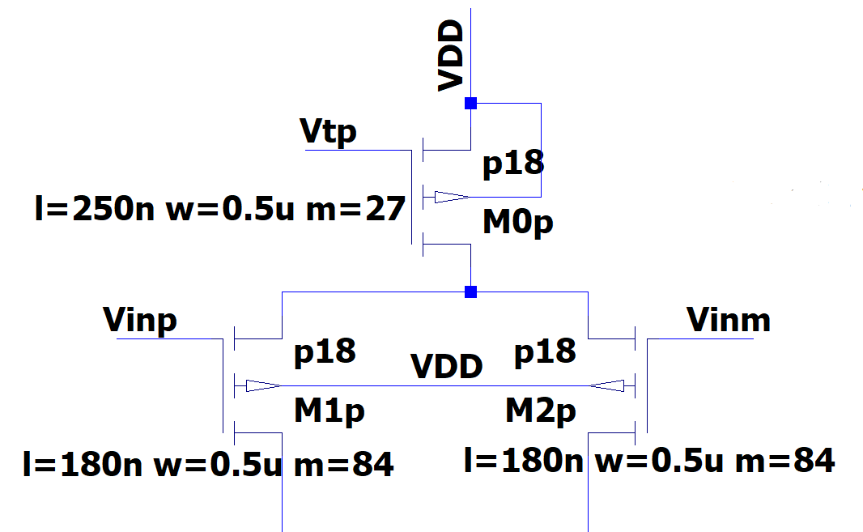
PMOS Input Pair
Name: m1p m2p
Model: p18 p18
Id: -6.30e-05 -6.30e-05
Vgs: -6.47e-01 -6.47e-01
Vds: -1.30e+00 -1.30e+00
Vbs: 2.53e-01 2.53e-01
Vth: -5.30e-01 -5.86e-01
Vdsat: -9.10e-02 -9.10e-02
Gm: 9.77e-04 9.77e-04
Gds: 1.67e-05 1.67e-05
m0p
p18
-1.26e-04
-7.17e-01
-2.53e-01
0.00e+00
-4.32e-01
-2.42e-01
7.37e-04
1.06e-04

Slide 15
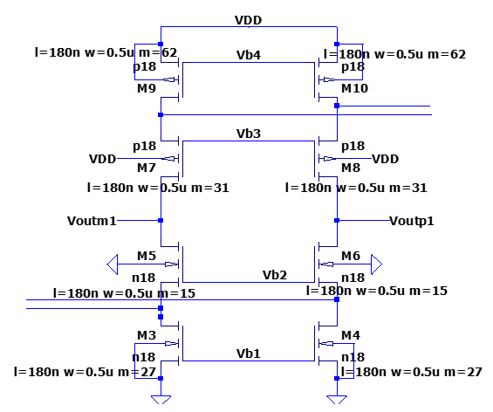



Main Transistor Stack

Slide 16
Main Transistor Stack
 | M3 | M5 | M7 | M9
I_{D} | 149μA | 86.1μA | 86.1μA | 160μA
V_{GS} | 601mV | 637mV | 759mV | 700mV
g_{m} | 1.75mS | 1.05mS | 0.841mS | 1.49mS
r_{o} | 10.2kΩ | 27.78kΩ | 56.82kΩ | 13.26kΩ

Slide 17
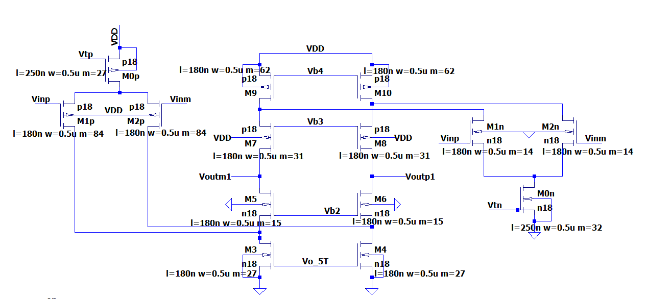
Circuit Design
NMOS-PMOS Folded Cascode design

Slide 18
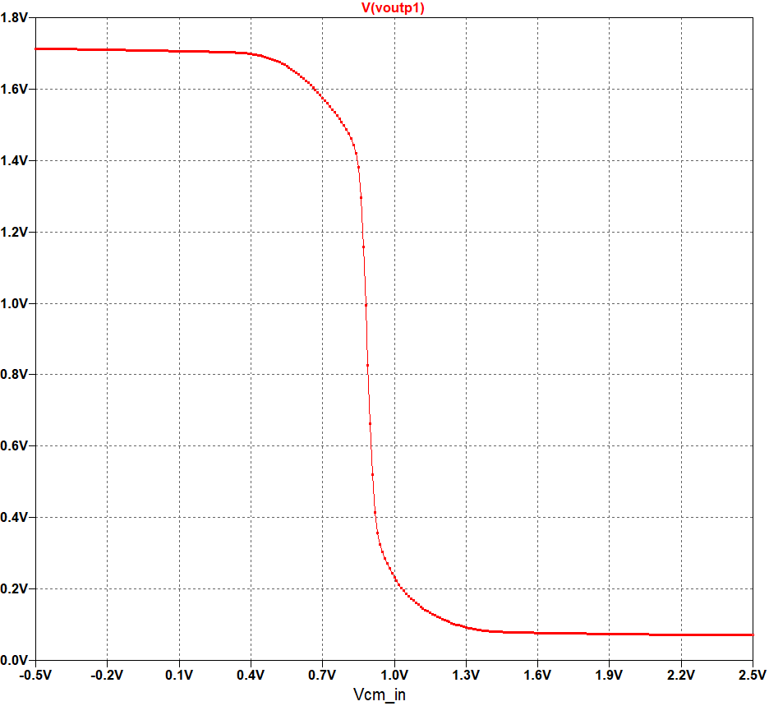
DC Analysis
Input CM Voltage
Sweep from -0.5V to 2.5V
Output DC Voltage
Range: 0.7V to 1V
Rail to Rail working capability
Input CM voltage
0.7V to 1V
Notes:
Enough Headroom in mid-range
Low headroom in upper and bottom range

Slide 19
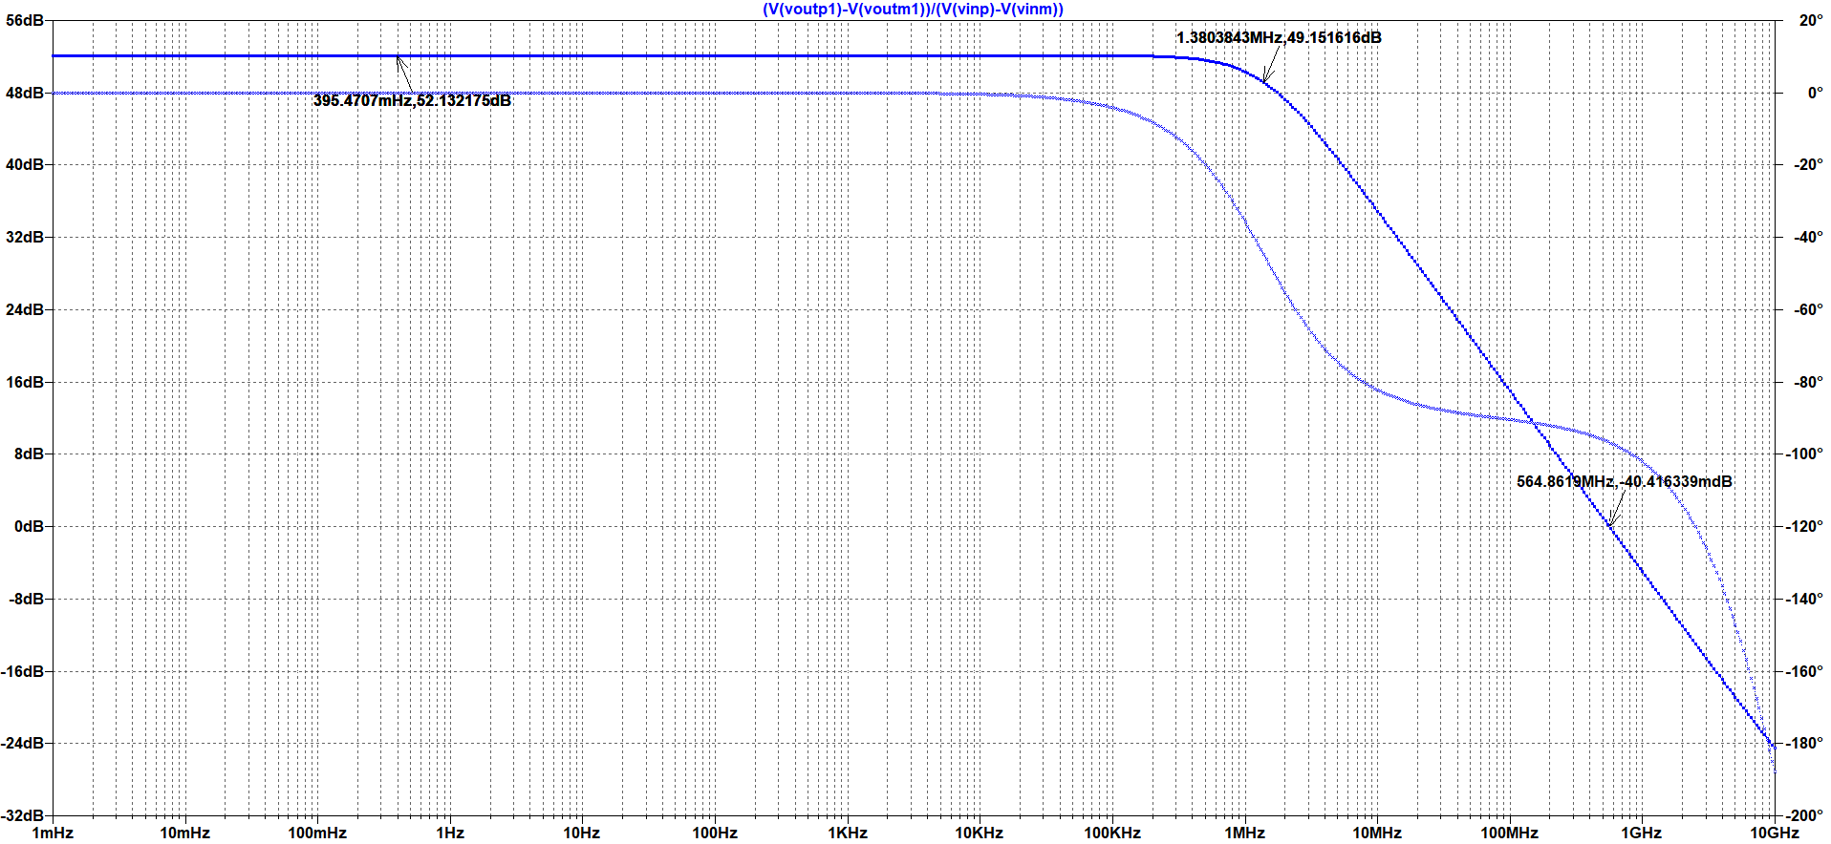
AC Analysis(V_{cm}=0.9V)
Notes:
~50 dB gain, 564 MHz – UGF, PM- >80 (because 1st stage only)

Slide 20
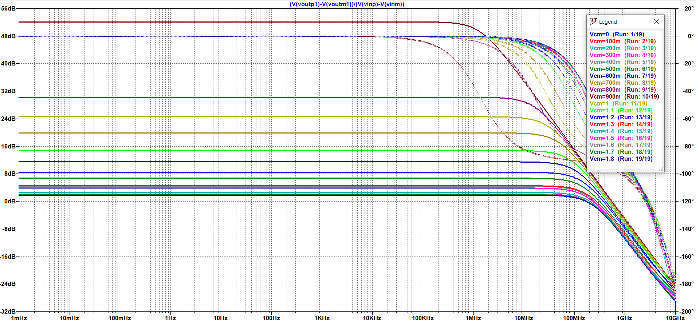
AC Analysis
Notes:
Working for input common mode voltage of 0.9 V
Low gain for other case of input -> not working rail to rail

Slide 21
CMFB

Slide 22
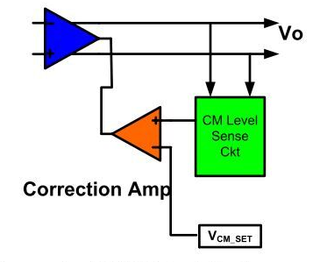
Principle of CMFB
Common Mode Feedback to correct for V_{cm} because of variation in PMOS and NMOS current pairs
Compare the Common mode voltage to reference voltage
Output signal of CMFB Stage can be fed back
Providing it on gate terminal helps in controlling V_{gs} and hence, current through it.

Slide 23
Detection of Common mode voltage
Sensed by simple resistor
But direct resistor comes parallel to R_{out}
Results in low gain
Require high value of Resistor
Solution is to use buffer stage
Followed by low value resistor to detect the output V_{CM}

Slide 24
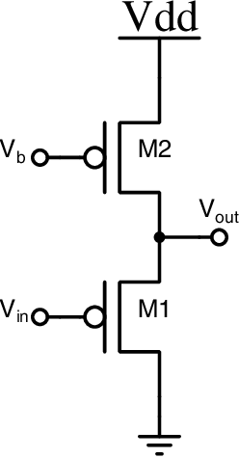
Source Follower
Benefits:
Very high input impedance
Price:
Voltage(V_{GS} ) drop across the M2 transistor
Reference voltage = V_{CMref}- V_{GS}
V_{CMref} = 0.9V
V_{GS} = 0.593V ≈ 0.6V
Notes:
High input impedance -> R_{out} won’t be affected

Slide 25
Correction for Common Mode voltage
Common Mode voltage detected
CMFB stage: 5T OTA
Output: Vo_5T
Reference voltage : (V-)
(V-) = V_{CMref} – V_{GS} = 0.3
Notes:
Now after the deduction of Vcm now we need to compensate for current difference, in this project, it is done by correcting nmos gate value. Here as you can see the voltage V- is used to be 0.3v as a reference source because of voltage drop across the buffer. Later we would see the variation in voltage

Slide 26
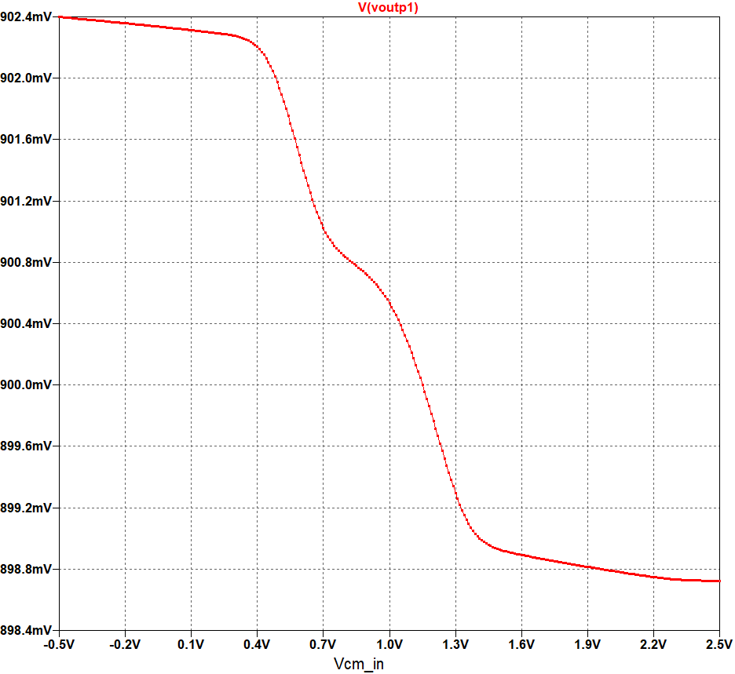
DC Analysis
Input CM Voltage
Sweep from -0.5V to 2.5V
Output DC Voltage
Not much Variation.
Rail to Rail working capability
Input CM voltage
Full Range
Notes:
After the addition of CMFB, we can see the output Common Mode voltage is improved drastically with a approx. voltage level of 900mv, this provide much more headroom for signal swing which was missing in the previous stage.

Slide 27
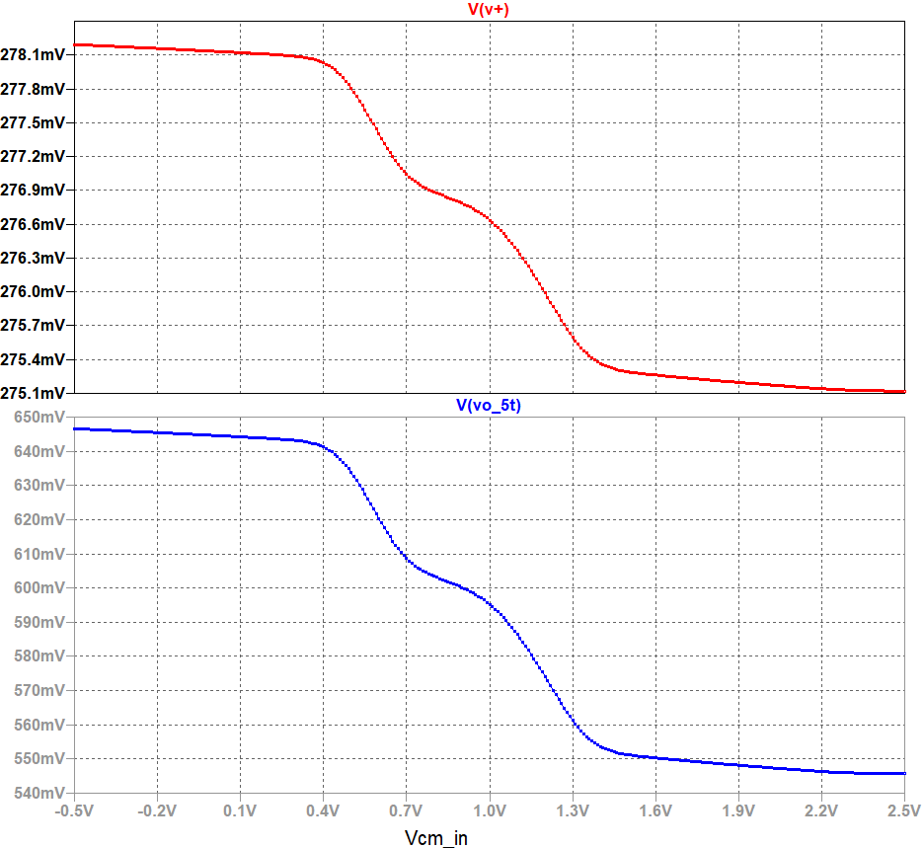
DC Analysis
Input CM Voltage
Sweep from -0.5V to 2.5V
Output CM Voltage
Range: 0.4V to 1.4V
Output of CMFB Stage
Range: 0.4V to 1.4V
Similar behavior
Notes:
Here we can see the variation in input to the 5T OTA with the Vcm sweep and similarly output of OTA, Here we can see the input to OTA is around 270mv because of the deduction of Vgm voltage from buffer stage

Slide 28
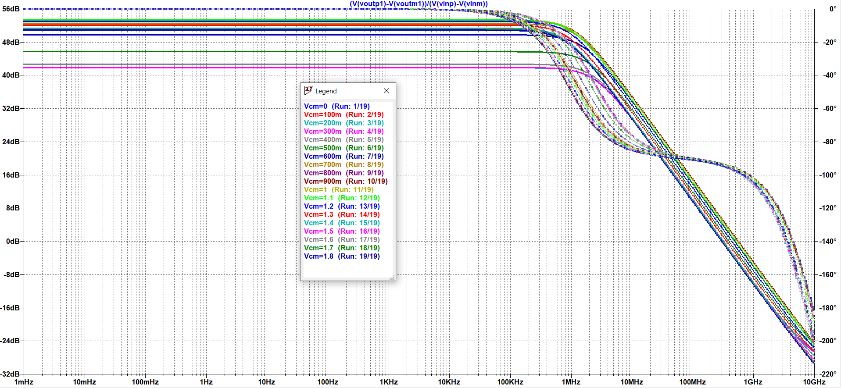
AC Analysis
Folded cascode with CMFB
Notes:
Now we can see the gain is much improved from the previous stage which had very less gain for values under 0.4 and 1v but still less than the required gain
Here we can see the gain is in the range of 50 db

Slide 29
Transient Analysis
To simulate current disturbance: extra current source used.
Current sources in parallel with the MOSFET
Current source: Pulse input
Notes:
Here we used an extra current source element to simulate for sudden change in current due to environmental factors.
we can see the current sources in parallel with the PMOS
Hence this will simulate for change in current level for NMOS and PMOS pairs
Now CMFB has to compensate for this change by correcting the NMOS current value, we would first see the transient analysis then proceed to voltage compensation

Slide 30
Results
T_{s} = 0.4µS
Notes:
Here we can see, first the transient analysis of the signal. The signal is almost perfect for complete duration of pulse and have a very small disturbance near the transition stage, this settling time was measured to be 0.4 us

Slide 31
Transient Voltage analysis
T_{s} = 0.4µS
Notes:
Now here we can see, as the current depicted in green graph drops, the value of the 5T OTA also drops, this is because as the parallel current source to pmos simulates for extra current in pmos pair than of nmos pair, and hence when the current source turns off, so pmos current also decrease hence now CMFB need to make sure the nmos current also need to be decreased, which is being done here as seen in the red graph, correspondingly we can see the change in the common mode voltage i.e, V+ is very less although we can see a disturbance in the signal, this disturbance is restricted to 0.4us only.

Slide 32
2nd Stage
Notes:
Moving on to next part that is the 2nd stage. As we have seen earlier that the gain of 1st stage with CMFB is in the range of around 48db to 50dB

Slide 33
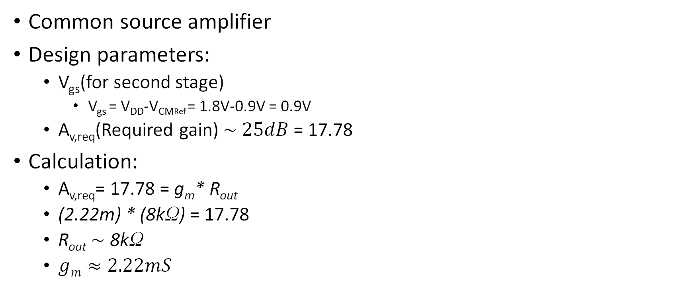
Design Budgeting
Common source amplifier
Design parameters:
V_{gs}(for second stage)
V_{gs} = V_{DD}-V_{CMRef} = 1.8V-0.9V = 0.9V
A_{v,req}(Required gain) $\sim 25dB$ = 17.78
Calculation:
A_{v,req}= 17.78 = g_{m}* R_{out}
(2.22m) * (8kΩ) = 17.78
R_{out}$\sim$ 8kΩ
$gm≈2.22mS$
Notes:
So we have implemented common source amp for this stage. Vgs for this was calculated and was found to be around 0.9V. And we designed it to give a gain of 25dB
Which is 17.78 in absolute value. We divided this gain in two parts 8k and 2.22m and took Rout to be 8k and gm to be 2.22ms.

Slide 34

PMOS Characterization
Scaling factor(multipliers) = $\frac{2.22mS}{60.023467μS}$ = 36.98 $≈$ 37
Notes:
Now comes the PMOS characterization. We can see from the plot that at 0.9V, gm is around 60us and requires is 2.22ms so we get the scaling factor as 37.

Slide 35
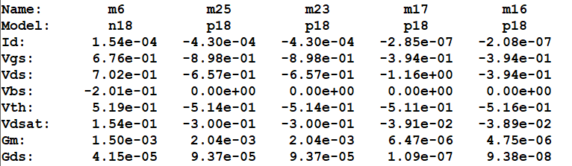
2nd Stage Design
2nd Stage Circuit
Operating Point
Notes:
then we implemented the CS Amp using scaled transistor here we can see that M25 is our main transistor and M26 is providing the required current required current to M25 using the current mirror explained by kshitij. This is the noperating point of the 2nd stage

Slide 36
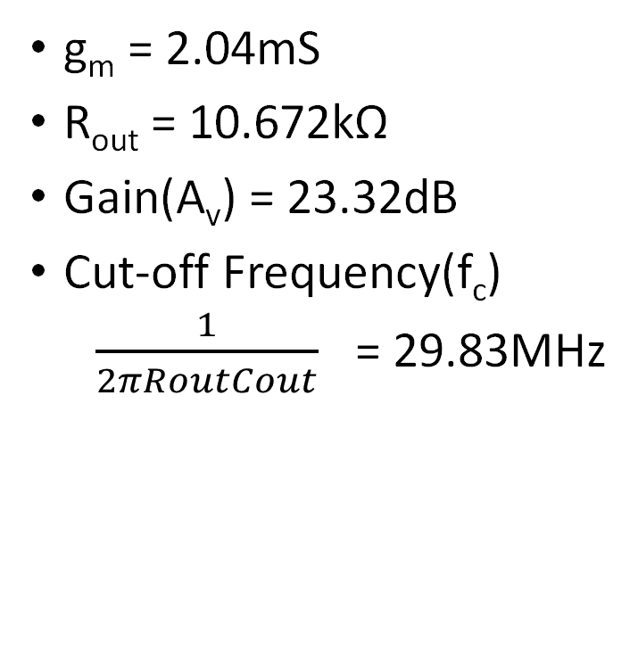
Simulation Results
g_{m} = 2.04mS
R_{out} = 10.672kΩ
Gain(A_{v}) = 23.32dB
Cut-off Frequency(f_{c})
$\frac{1}{2πRoutCout}$ = 29.83MHz
Gain Plot
Notes:
So now this is the simulation result for this stage. This is the AC gain plot of the 2nd stage and we can see that we got gm to be 2.04mS and Rout and Av and Cut off freq

Slide 37
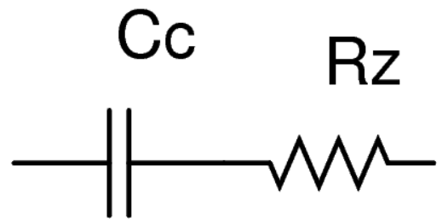

Phase Compensation(Miller compensation)
Resistor Calculation:
R_{z}$>\frac{1}{gm}$
$\frac{1}{gm}$ = 490.196Ω
Taking R_{z}=500Ω
Taking arbitrary value for capacitor c_{c} = 500fF
Notes:
The phase margin that we were getting for both the stages and CMFB combined came out to be –ve so we have used the miller compensation for the phase compensation. It is basically adding capacitor between the Input and output of 2nd shifting the dominant pole(ie 1st stage) to right hand side improving the GM but at the same time it also introduces a zero in RHP which overall deteriorates our overall phase margin so we add a resistor almost equal to 1/gm and greater then that. So we took rz as 500 and took a arbitrary value of c as 500fF

Slide 38
Circuit Design
2nd Stage with miller compensation(between 1st and 2nd stage)
Notes:
Here we can see the circuit design which is basically adding this R and C

Slide 39
Simulation result
Without Miller Compensation
With Miller Compensation
Gain Cross-over frequency = 1.584GHz
Phase margin = -201.48+180 = -21.48(Unstable)
Gain Cross-over frequency = 263.02 MHz
Phase margin = -117.81+180 = 62.19(stable)
Notes:
Now this is sim results phase margin was -21.48 that means the system is unstable(oscillations) after compensation we got pm of 61.2 which is very good and we can see that UGF is 263MHz which satisfies our design requirement of UGF >100MHz

Slide 40
Results

Slide 41
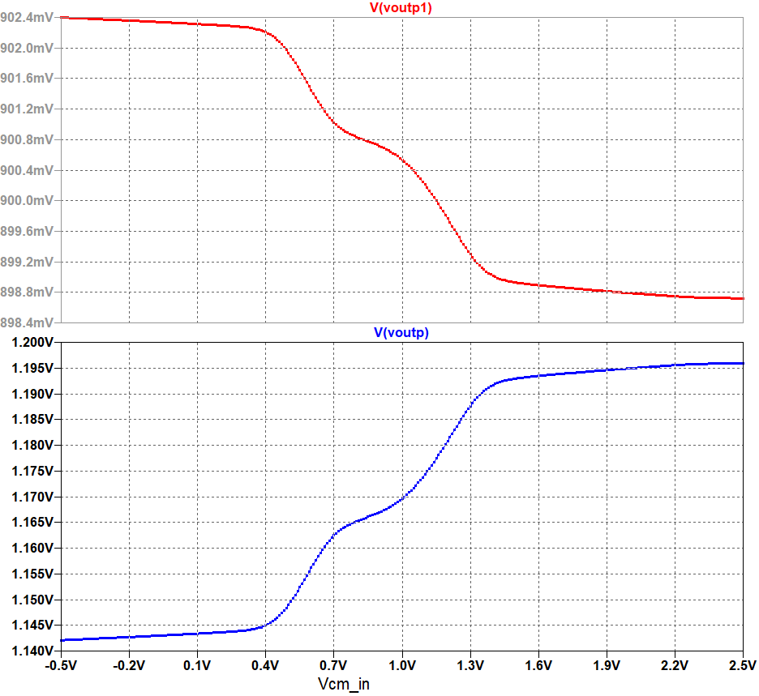
DC Analysis
Input CM Voltage
Sweep from -0.5V to 2.5V
Output DC Voltage of Stage-1
Range: 0.4V to 1.4V
Not much variation
Output DC Voltage of Stage-2 (Final O/P)
Range: 0.4V to 1.4V
Not much variation
Rail to Rail working capability
Input CM voltage – Full Range
Notes:
Enough Headroom in mid-range as well as low and high range

Slide 42
AC Analysis (V_{CM} = 0.9V)
Notes:
76 dB gain, 436 MHz, PM - 48

Slide 43
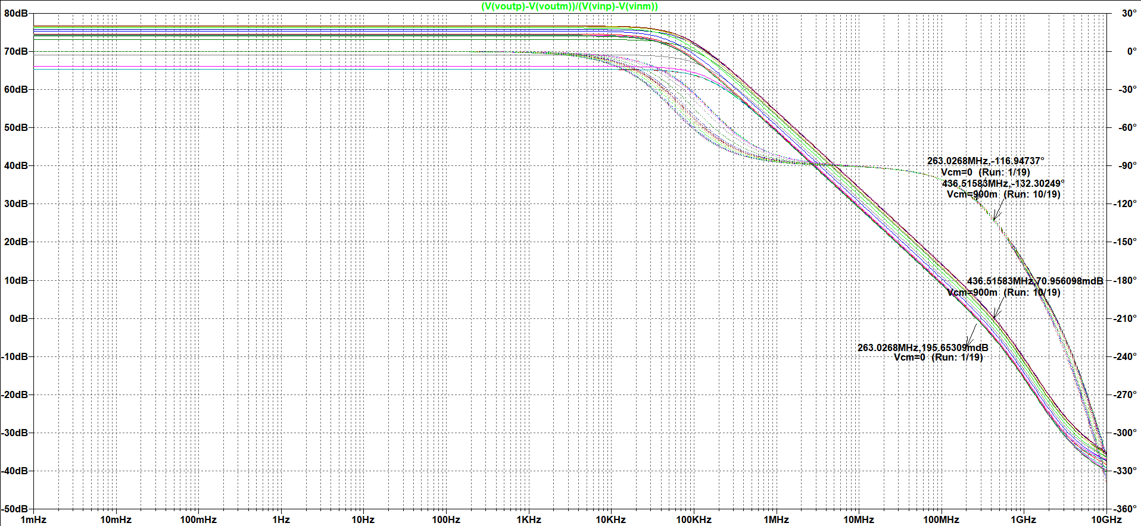
AC Analysis (V_{CM} sweep)
Notes:
Input CM sweep – 0 to 1.8 V
gain- not much change
Only 2-3 case – slightly less than 70 dB but it’s good.
We can say it is working in full rail-to-rail input range

Slide 44
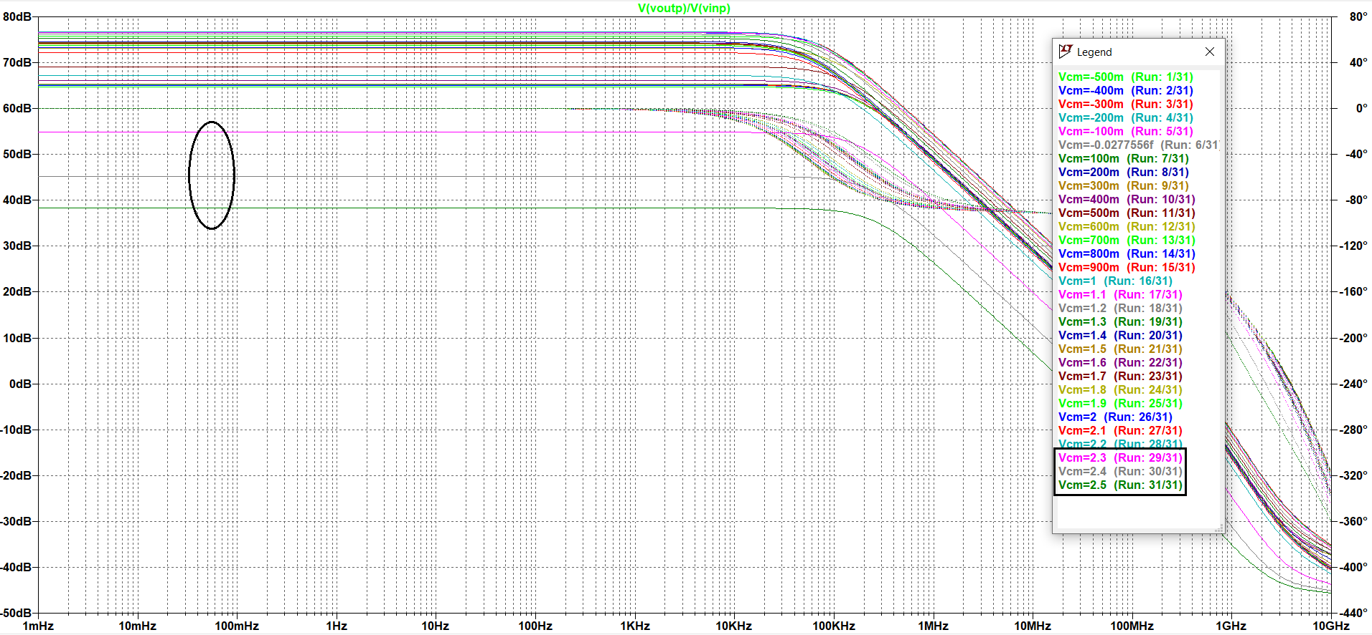
AC Analysis (V_{CM} sweep)
Notes:
Then we increase the input CM range..
-0.5V to 2.5V
Working fine for all the cases except last 3 cases..

Slide 45
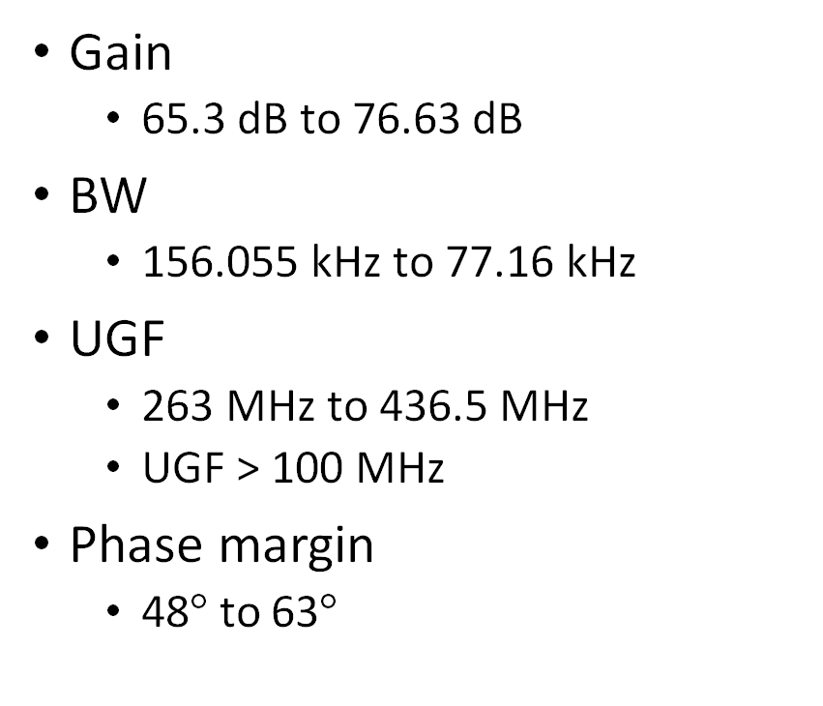
Results & Conclusion
Gain
65.3 dB to 76.63 dB
BW
156.055 kHz to 77.16 kHz
UGF
263 MHz to 436.5 MHz
UGF > 100 MHz
Phase margin
48$°$ to 63$°$
Power Consumption (Overall)
1.8*1.37m = 2.467mW
Power Consumption (w/o bias)
1.8*1.33m = 2.39mW
Input common mode range
Rail-to-Rail
CMFB
Working

Slide 46
Improvements
Rail-to-Rail input capabilities in stage-1 (folded cascode)
Gm Calibration
Overall Gain Improvements

Slide 47
References
Design of Analog CMOS Integrated Circuits, B. Razavi
ECEN474/704: (Analog) VLSI Circuit Design (Spring 2018), Sam Palermo Analog & Mixed-Signal Center, Texas A&M University
Lecture 15: Fully Differential Amplifiers & CMFB
Lecture 17: Fully Differential Amplifiers & CMFB
Lecture notes

Slide 48
THANK YOU!

